Slide 1
Code Institute
Full Stack Software Developer Course - 2020
Milestone Project P1 – Planes Analysis
Bowen Therapist’s Website
www.mlbowen.com
Source : Planes Analysis : The Elements of User Experience by Jesse James Garrett
© Kieron O’Connell trading as KJO Associates

Slide 2
Planes Analysis Contents
Surface
Skeleton
Structure
Scope
Strategy
Proprietary & Confidential
© Kieron O’Connell trading as KJO Associates

Slide 3
Strategy - Background
What | A small website
For | Mary Lou O’Connell - Bowen Therapist
Brand name | ML Bowen
High level description | Bowen Therapy is a gentle hands on complimentary therapy that targets the nerve paths of the body and aids in pain relief and a range of associated conditions as well as aiding relaxation and stress reduction.
Overall aim | To form part of ML Bowen’s marketing and sales activities to sell and promote Bowen Therapy.
Domain name | www.mlbowen.com | Status | Registered & owned
New or Existing site | New
Proprietary & Confidential
© Kieron O’Connell trading as KJO Associates

Slide 4
Strategy – Primary Bowen Therapy communication goals
ML Bowen |  |  | Potential Customer
Opportunity | Purpose |  | Outcome after finding ML Bowen | Need
Describe Bowen Therapy and what it can do | Demonstrate that the Therapy can help. |  | Belief that the therapy can help. | Have a physical ailment and looking for complimentary solutions
Define the skills and experience of the therapist | Demonstrate the skill, ability and experience of the therapist |  | Confidence in Therapist’s knowledge, qualifications and ability. | Wants to know that the person doing the treatment is bone fide
Describe treatment | Disclose details of what happens |  | Build trust and take away unknowns that could generate fears or uncertainty. | Don’t know what is involved in treatment
Describe effects of treatment | Disclose details of what the patient might feel/experience during or after treatment |  | Builds trust and prepares customer for range of outcomes as well as removing fears/uncertainty. | How will I feel / what will I experience during or after treatment
Describe treatment location | Show and/or describe treatment environment |  | Create confidence in appropriateness and pleasantness of environment. | Where will I be treated? Will I feel comfortable their?
Match ?
Match ?
Match ?
Match ?
Match ?
Proprietary & Confidential
© Kieron O’Connell trading as KJO Associates

Slide 5
Strategy – Private therapy business : Main process
Contact
Point of Sale
Close
Generating Pipeline
Sales Pipeline
Delivery
Feedback
Repeat
Main
Business
Process
Marketing & Promotion
1st Contact
Securing Sales
Booking Process
Treatment Process
1
Treatment Process
2
Treatment Process
3
Referral / Recommendation
Main
Activities / data
Main marketing channels
Social Media
Events
Direct promotion
Friends & Family
Word of Mouth
Main landing/reference point for business
Website
Linked reference points
  Industry websites
  Expert articles
Matching needs to solutions
Can Bowen Therapy help your situation?
Credibility
Who is the practitioner?
Are they qualified?
Does it ‘feel right’ ?
Administrative
Contact details ( & database)
Permissions
Calendars
Taking payment
Treatment records & notes
Patient handling during treatment
Patient follow up
Promotions
Testimonial management
Creating repeat business environment
Regulatory
Information, statements & claims about treatment
Qualifications
GDPR
Secure storage
GDPR
Secure storage
Proprietary & Confidential
© Kieron O’Connell trading as KJO Associates

Slide 6
Strategy - Primary Features
No. | Feature | Importance | Viability
1) Description of Bowen Therapy
1.1 | Written description | 4.5 | 5
1.2 | Diagrams and/or photos of treatment basis | 4.5 | 3
1.3 | Video of experts explaining Therapy | 5 | 2
2) Therapist & skills
2.1 | Written description | 5 | 5
2.2 | Photo | 5 | 5
2.2 | Qualifications | 5 | 5
2.3 | Links to Industry accreditation bodies | 5 | 5
3) Description of treatment
3.3 | Written description | 5 | 5
3.4 | Diagrammatic description | 4 | 2
4) Effects and outcomes of treatment
4.1 | Written description | 5 | 5
5) Treatment location and environment
5.1 | Description | 3 | 5
5.2 | Photographs | 5 | 4
TOTALS |  | 56 | 51
Proprietary & Confidential
© Kieron O’Connell trading as KJO Associates

Slide 7
Strategy – Supporting & Administrative Features
No. | Feature | Importance | Viability
1) Contact
1.1 | Contact details | 4.5 | 5
1.2 | Contact form linked to ML Bowen email with simple requests function | 4.5 | 3
2) Booking
2.1 | Direct booking form linked to ML Bowen email and database but manual mgmt. | 5 | 3
2.2 | Calendar allowing direct booking of treatment slot(s) linked to availability calendar | 4.5 | 2
3) Payment
3.1 | Facility to take card payments or other electronic payments at time of booking | 5 | 1
4) Testimonials, references and referrals
4.1 | Posting and updating of customer testimonials by ML Bowen | 5 | 5
4.2 | Highly visible expert referrals/references | 5 | 2
4.3 | Ability for customers to post testimonials directly | 3 | 1
5) Rules and regulations
5.1 | GDPR Statement | 3 | 5
TOTALS |  | 39.5 | 27
Proprietary & Confidential
© Kieron O’Connell trading as KJO Associates

Slide 8
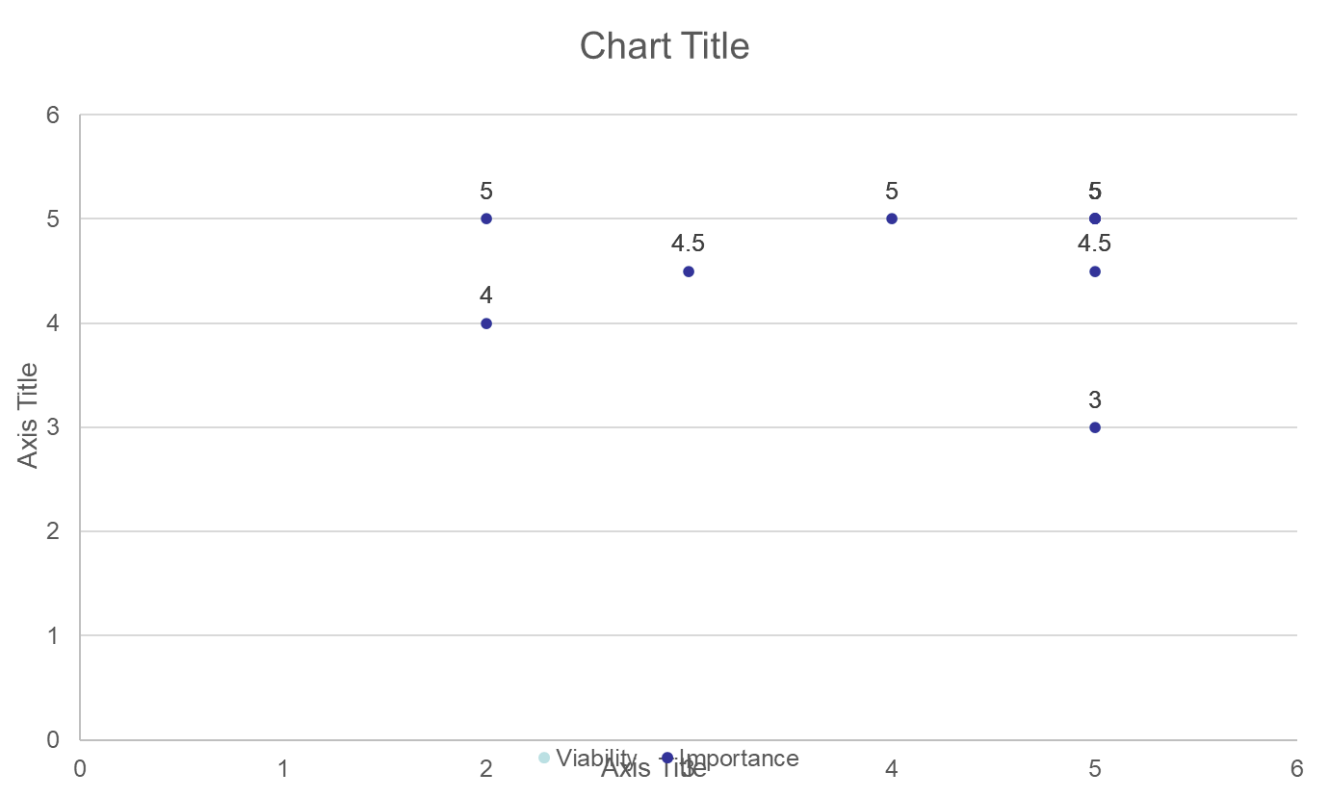
Strategy – Supporting & Administrative Features
Proprietary & Confidential
© Kieron O’Connell trading as KJO Associates

Slide 9
Scope
Proprietary & Confidential
© Kieron O’Connell trading as KJO Associates

Slide 10
Structure
Proprietary & Confidential
© Kieron O’Connell trading as KJO Associates

Slide 11
Skeleton
Proprietary & Confidential
© Kieron O’Connell trading as KJO Associates

Slide 12

Surface
Fonts
Colours
Backgrounds
Pictures
Videos
Proprietary & Confidential
© Kieron O’Connell trading as KJO Associates

